Slide 2
develop understanding about the basics of insert the missing character,
analyze different types of insert the missing character,
solve various problems relating to insert the missing character.

Slide 3
Insert The Missing Character
Figure/Set of Figures/Arrangement/Matrix
Certain Characteristics
  Numbers/Letters/Group
  Combination of Letters/Numbers
Missing Character

Slide 4
Insert The Missing Character
Set of Figures
Set of Arrangements
Set of Matrix

Slide 5
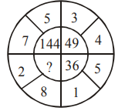

Problem
What number should replace the question mark?
(a) 64
(b) 68
(c) 82
(d) 100
Explanation:
Required number = ${\left(\text{2 + 8}\right)}^{\text{2}}$ = 100

Slide 6
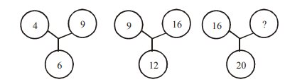
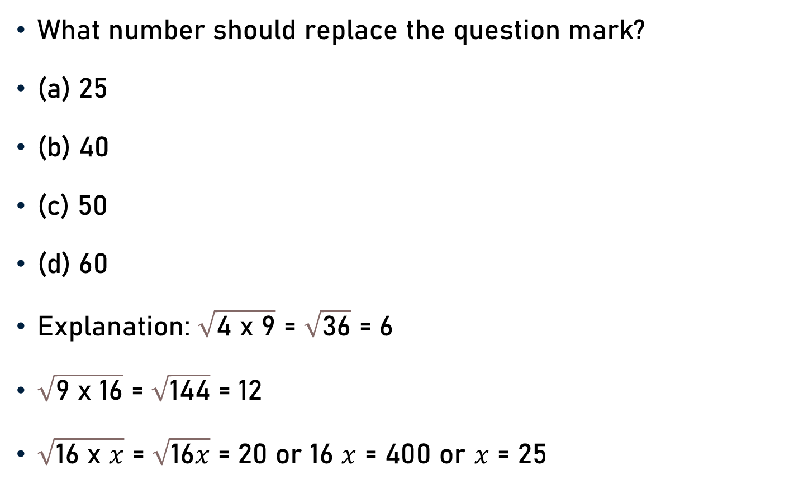
Problem
What number should replace the question mark?
(a) 25
(b) 40
(c) 50
(d) 60
Explanation: $\sqrt{\text{4} \text{x} \text{9}}$ = $\sqrt{\text{36}}$ = 6
$\sqrt{\text{9} \text{x}\text{ 16}}$ = $\sqrt{\text{144}}$ = 12
$\sqrt{\text{16} \text{x} x}$ = $\sqrt{\text{1}\text{6}x}$ = 20 or 16 $x$ = 400 or $x$ = 25
25

Slide 7
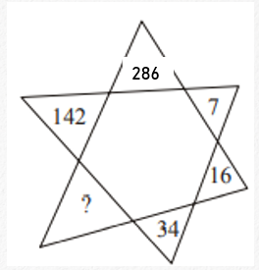
Problem
What number should replace the question mark?
(a) 66
(b) 68
(c) 70
(d) 72
Explanation:
Starting with 7, Double the number and add 2.

Slide 8
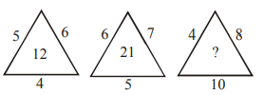
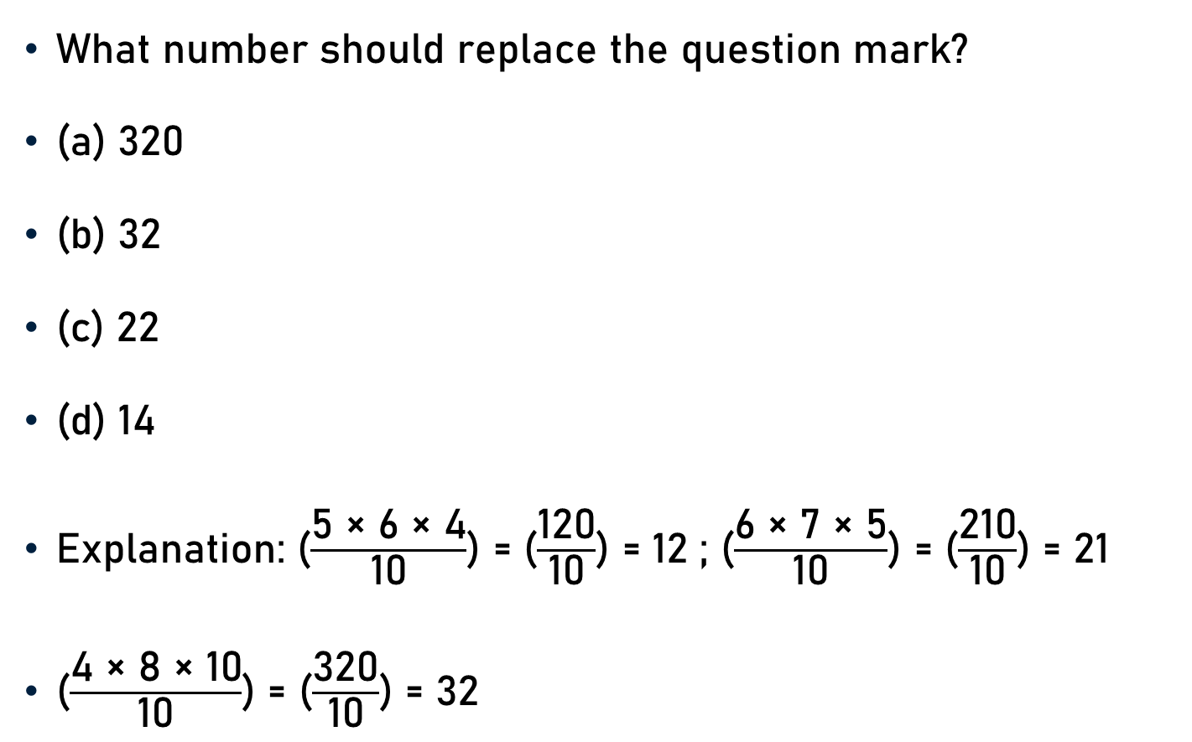
Problem
What number should replace the question mark?
(a) 320
(b) 32
(c) 22
(d) 14
Explanation: ($\frac{\text{5 × 6 × 4}}{\text{10}}$) = ($\frac{\text{120}}{\text{10}}$) = 12 ; ($\frac{\text{6 × 7 × 5}}{\text{10}}$) = ($\frac{\text{210}}{\text{10}}$) = 21
($\frac{\text{4 × 8 × 10}}{\text{10}}$) = ($\frac{\text{320}}{\text{10}}$) = 32

Slide 9
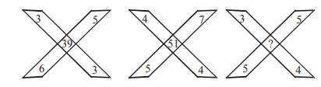
Problem
What number should replace the question mark?
(a) 45
(b) 47
(c) 35
(d) 37
Explanation:
3 × 3 + 6 × 5 = 39 and 4 × 4 + 5 × 7 = 51
3 × 4 + 5 × 5 = 37

Slide 10
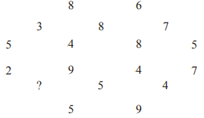
Problem
What number should replace the question mark?
(a) 9
(b) 8
(c) 7
(d) 6
Explanation:
Total of rows having two & four numbers = 14 & 22
Total of rows having three numbers =18

Slide 11
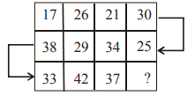
Problem
What number should replace the question mark?
(a) 42
(b) 32
(c) 46
(d) 45
Explanation:
Beginning at 17, +9 and –5.

Slide 12
Problem
What number should replace the question mark?
4322 : 48
4172 : 56
7615 : ?
(a) 49 (b) 52 (c) 210 (d) 336
Explanation: 4 x 3 x 2 x 2 = 48; 4 x 1 x 7 x 2 = 56
7 × 6 × 1 × 5 = 210

Slide 13
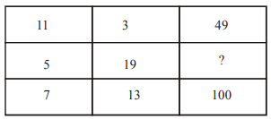
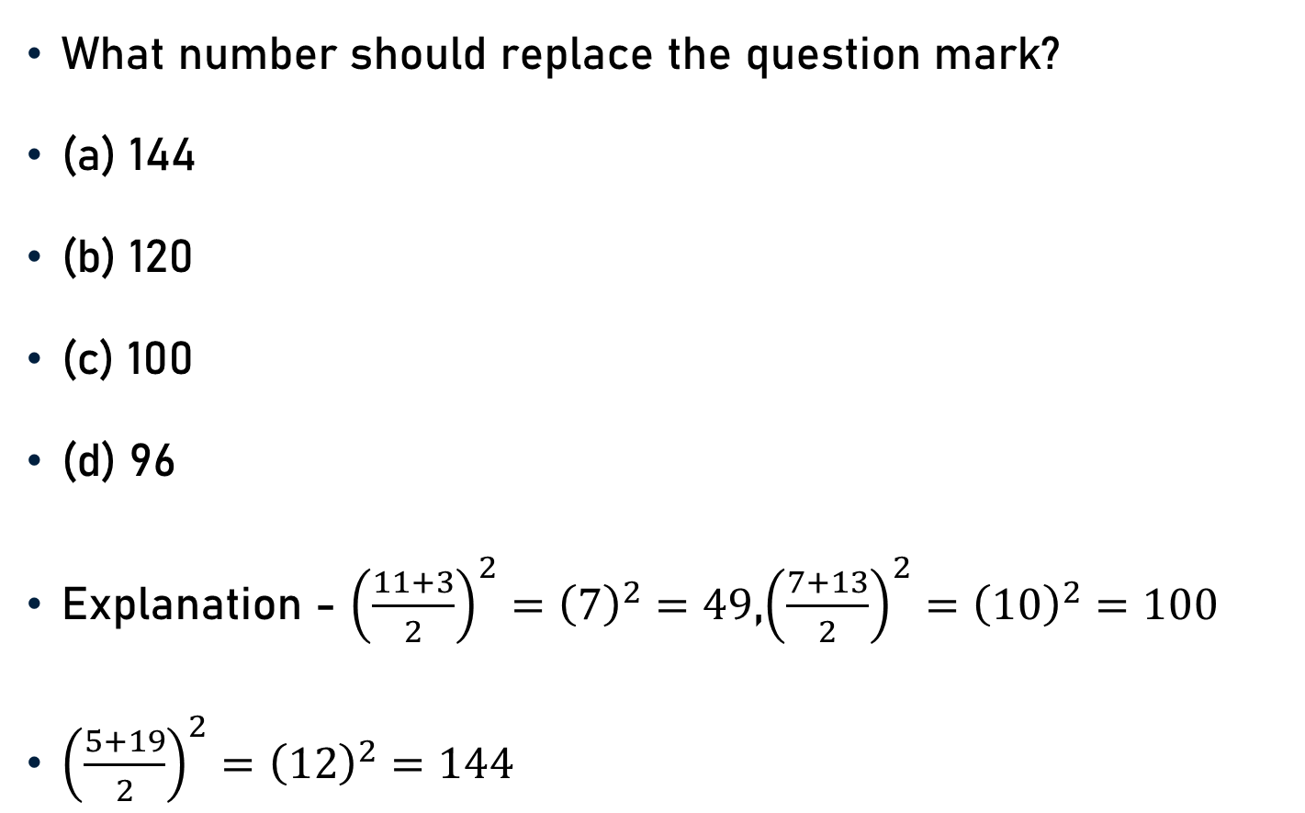
Problem
What number should replace the question mark?
(a) 144
(b) 120
(c) 100
(d) 96
Explanation - ${\left(\frac{11+3}{2}\right)}^{2}={\left(7\right)}^{2}=49$,${\left(\frac{7+13}{2}\right)}^{2}={\left(10\right)}^{2}=100$
${\left(\frac{5+19}{2}\right)}^{2}={\left(12\right)}^{2}=144$

Slide 14
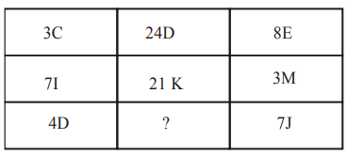
Problem
What number should replace the question mark?
(a) 11 E (b) 28 G
(c) 35 I (d) 48 F
Explanation
Number is the product of the two numbers.
1st row-letters are consecutive (CDE).
2nd row, letters are +1 (IJKLM).
3rd row, the letters are + 2 forward (DEFGHIJ).
4 × 7 = 28 and G.

Slide 15
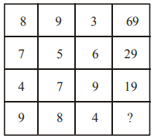
Problem
What number should replace the question mark?
(a) 86 (b) 98
(c) 68 (d) 43
Explanation
(8 × 9) – 3 = 69
(7 × 5) – 6 = 29
(4 × 7) – 9 = 19
(9 × 8) – 4 = 68

Slide 16
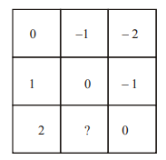
Problem
What number should replace the question mark?
(a) 4
(b) 1
(c) -1
(d) -2

Slide 17

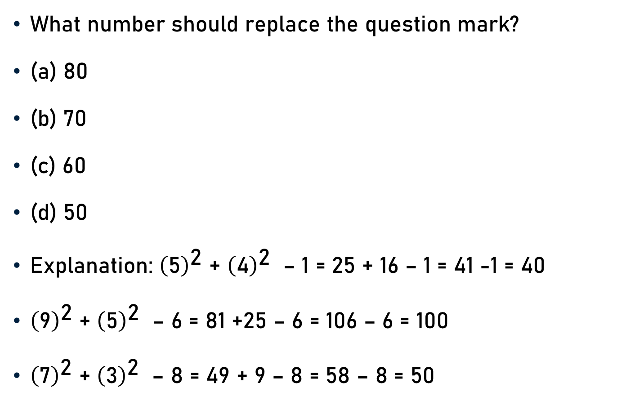
Problem
What number should replace the question mark?
(a) 80
(b) 70
(c) 60
(d) 50
Explanation: ${\left(\text{5}\right)}^{\text{2}}$ + ${\left(\text{4}\right)}^{\text{2}}$ – 1 = 25 + 16 – 1 = 41 -1 = 40
${\left(\text{9}\right)}^{\text{2}}$ + ${\left(\text{5}\right)}^{\text{2}}$ – 6 = 81 +25 – 6 = 106 – 6 = 100
${\left(\text{7}\right)}^{\text{2}}$ + ${\left(\text{3}\right)}^{\text{2}}$ – 8 = 49 + 9 – 8 = 58 – 8 = 50

Slide 18
Conclusion
Insert The Missing Character
  Figure/Set of Figures/Arrangement/Matrix
  Certain Characteristics
  Missing Character

Slide 19
Summary
Insert The Missing Character
    Set of Figures
    Set of Arrangements
    Set of Matrix

